Slide 1
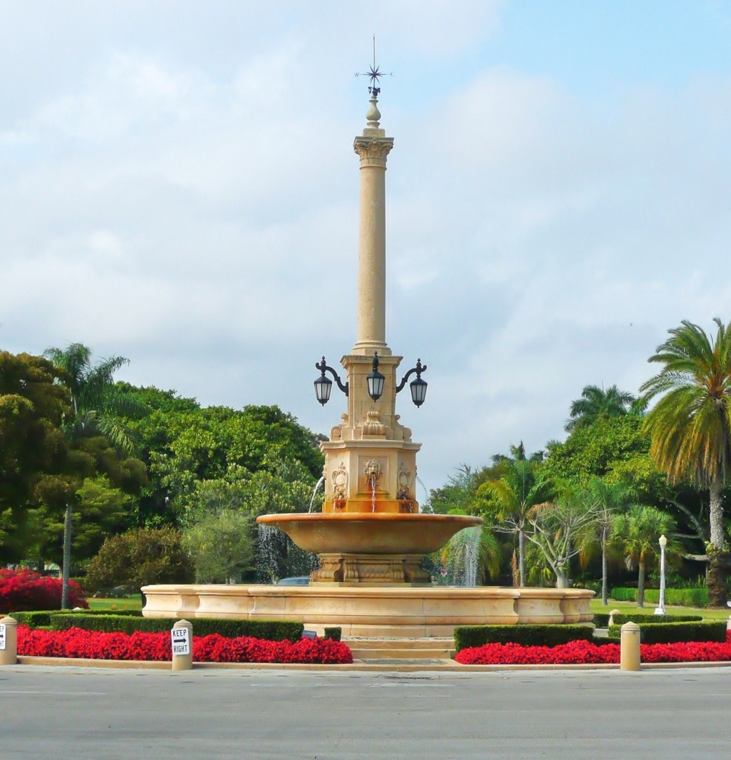




Community Meeting for
Little Gables
Proposed Annexation
PRESENTED BY
Jorge Duyos
September 27, 2023

Slide 2
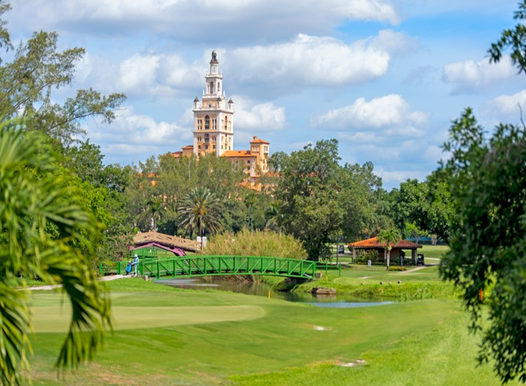

Why are We Here?
Meet the JRD Team
Speak generally about the annexation process
Provide an overview of Coral Gables services
Present financial impacts of annexation
Answer any questions you may have
2

Slide 3
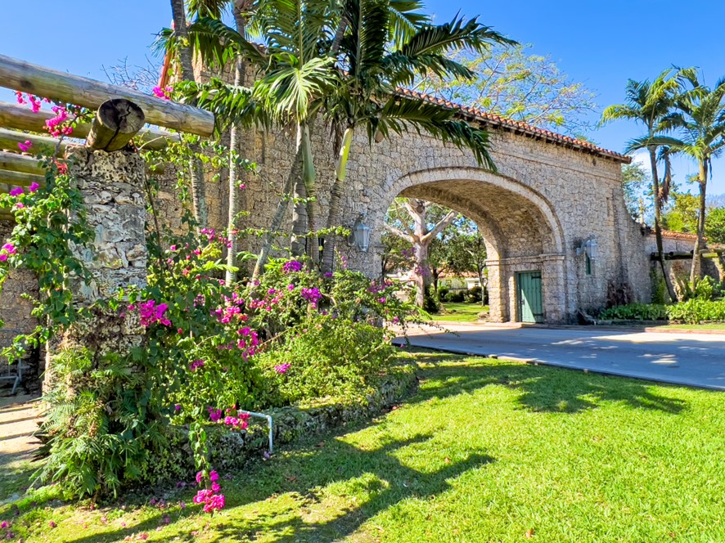
Some Housekeeping
Meet the JRD Team
Sign-in sheet
Speaker cards
Petitions
Speaker guidelines
Decorum
3

Slide 4

Annexation Process To Date
Meet the JRD Team
City Commission passed resolution directing staff to initiate annexation process for Little Gables
City conducted analysis to determine resource and financial requirements for proposed annexed area
City mailed meeting notice flyers and petition cards to all residents of Little Gables who are registered voters (1,661). We request receipt of signed petitions by 10/9/23
City conducts community meeting to inform Little Gables residents of the annexation process, City services, and financial impact of annexation
4

Slide 5
Annexation Petition
Meet the JRD Team
5

Slide 6
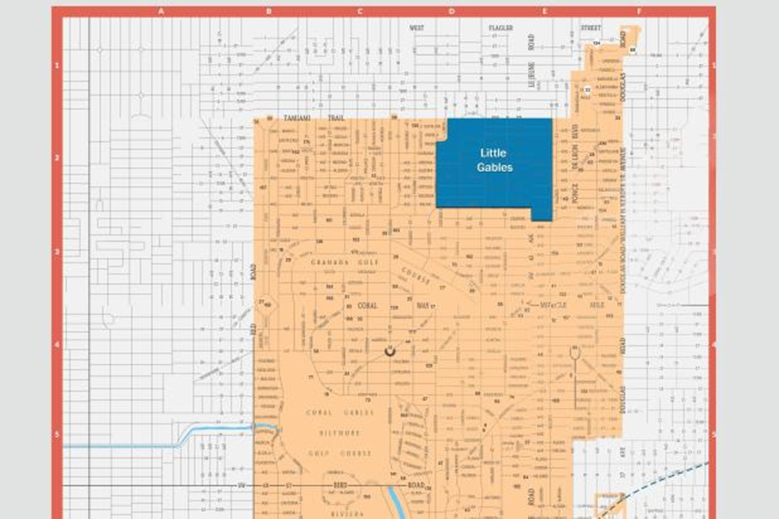
Meet the JRD Team
Little Gables Neighborhood
6

Slide 7
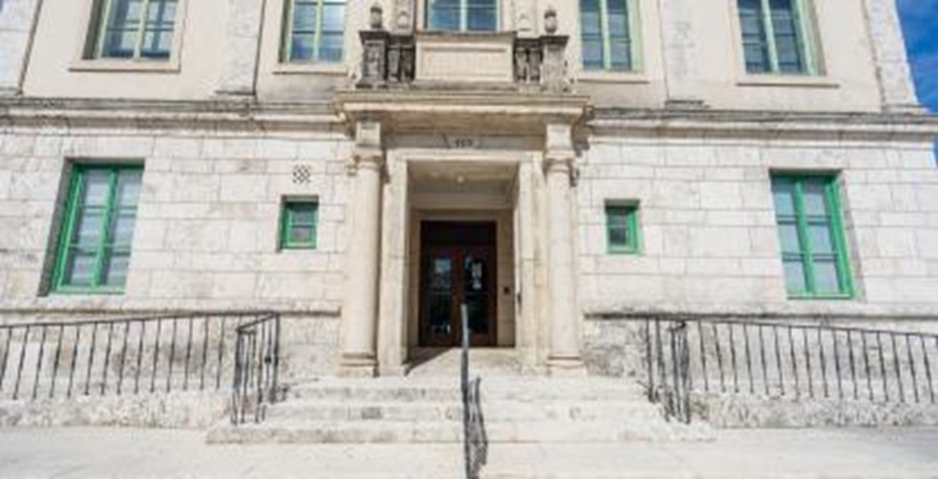
Meet the JRD Team
City’s Financial Stability
AAA bond rating from Standard and Poor's, Fitch and Moody’s rating services, one of only three cities in Florida to have these ratings from all three agencies
Over $50 million in general fund reserves (approximately 25% of the operating budget), which further indicates its strong financial position and allows the city to deal with emergencies such as hurricanes more effectively
Property tax rate (millage) unchanged for the last nine years
7

Slide 8
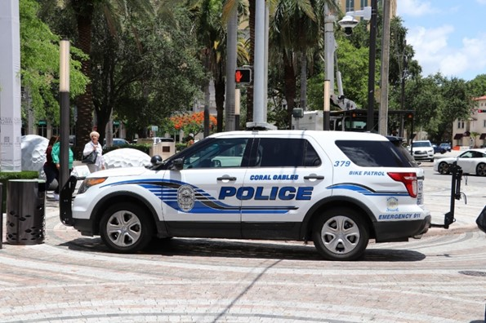
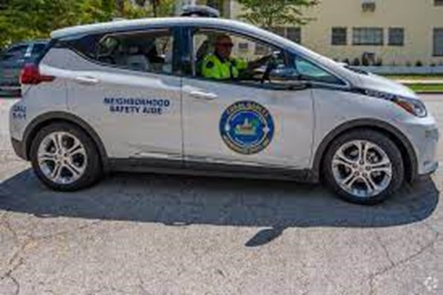
Meet the JRD Team
Police Services
Full-service police operations
  Dedicated 911 communications center, marine patrol, traffic enforcement, a crisis management team, and a youth resource unit
CALEA (Commission on Accreditation for Law Enforcement Agencies) accreditation – Gold Standard
4.66 officers per one thousand residents, well above the national ratio of 2.33 officers
Average response time to emergency calls of less than 3 minutes from time 911 call received
8

Slide 9
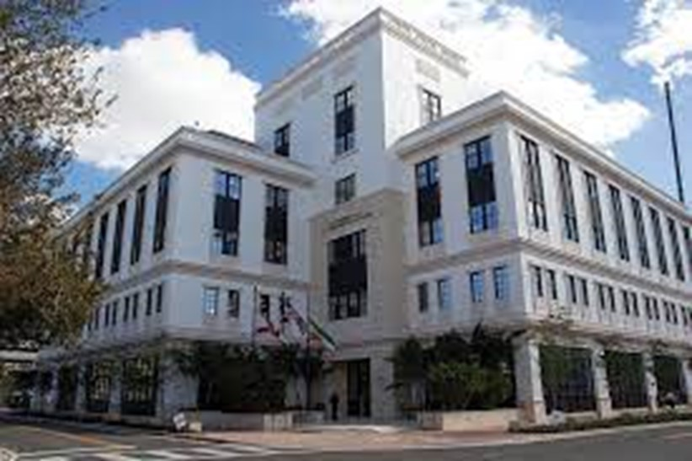
Meet the JRD Team
Police Services
199 sworn police officers, 5 additional in FY24, another 5 additional in FY25
If annexed, Little Gables would have additional resources
  3 police officers
  1 Neighborhood safety aide (NSA)
  Zone coverage
Neighborhood Team Leader and Neighborhood Safety Aides
9

Slide 10
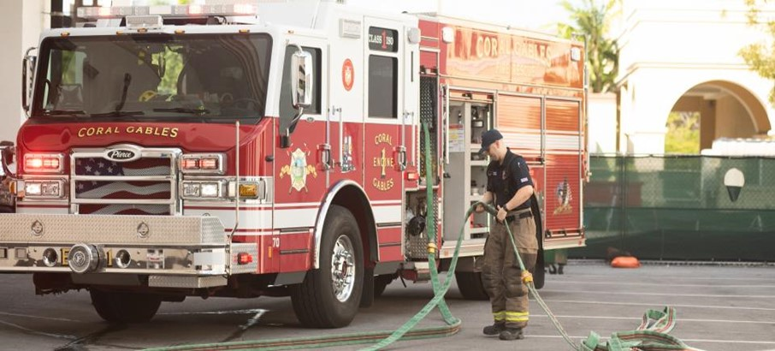
Meet the JRD Team
Fire and Rescue Services
Commission on Fire Accreditation International (CFAI) with an ISO Class 1 Rating
Average Response Time of 6:12 from time 911 call received
Historically, 95% patient satisfaction
Emergency management functions
10
Notes:
The Coral Gables Fire Department is 1 of only 15 Fire Departments in Florida accredited by the Commission on Fire Accreditation International (CFAI) with an ISO Class 1 Rating

Slide 11
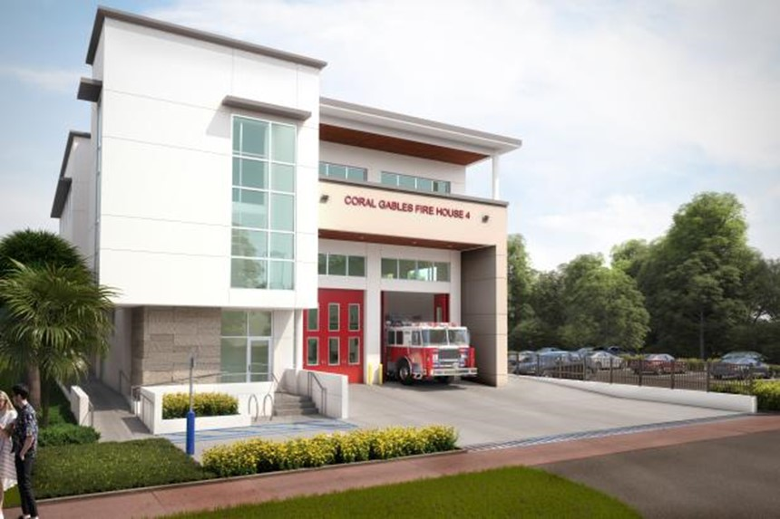
Meet the JRD Team
Fire and Rescue Services
City Fire Stations
  Station 1 – 2151 Salzedo St
  Station 2 – 525 South Dixie Highway
  Station 3 – 11911 Old Cutler Road
  Station 4 – 1345 Sunset Drive (breaking ground this year)
145 firefighters (5 additional in FY24, another 5 additional in FY25)
If annexed, Little Gables would have additional resources
  6 firefighters for 24/7 coverage
11

Slide 12
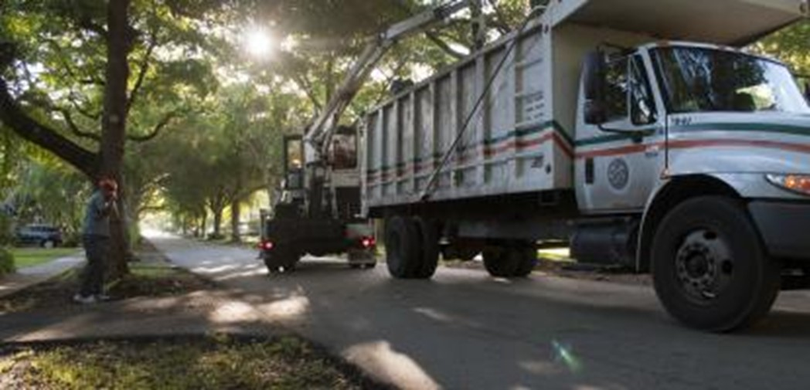
Meet the JRD Team
Residential Waste Services
City garbage pick-up at the back or side of house twice a week by fully vetted city employees
City recycling pick-up once a week
Bulky waste picked up once a week
If annexed, Little Gables would have additional resources
12

Slide 13
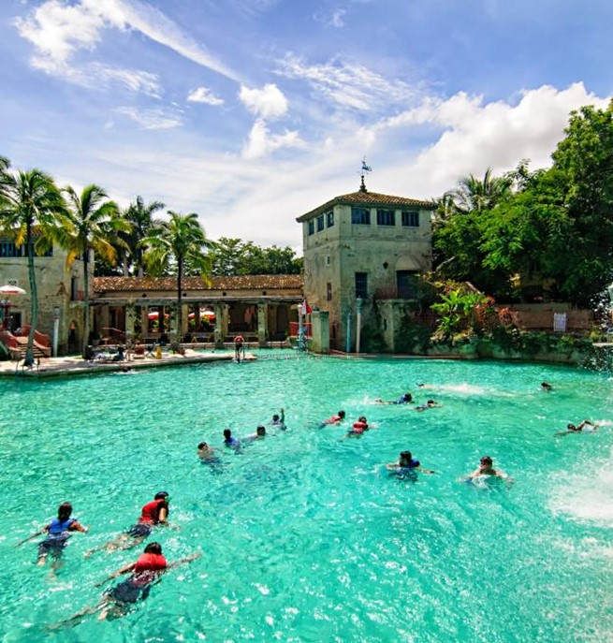
Meet the JRD Team
Community Recreation
Commission on Accreditation for Park and Recreation Agencies (CAPRA) accreditation
Over 60 parks and green spaces
Committed to continuing the development and renovation of neighborhood parks
San Jacinto Park
Goal is to have a park within a 10-minute walk of any residence
13

Slide 14
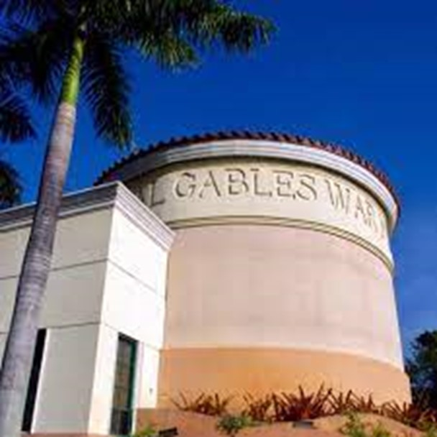
Meet the JRD Team
Community Recreation
Discounted resident rates and priority access at City recreational facilities
  Biltmore and Granada golf courses
  War Memorial Youth Center programs and summer camps
  Tennis Center
  Venetian Pool
  Adult Activities Center
  Coral Gables Country Club
  UM Athletic Events
14

Slide 15
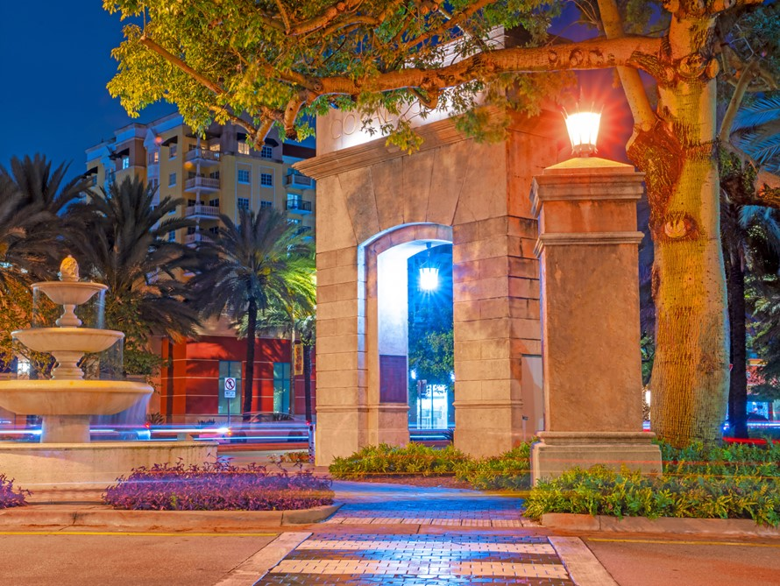
Meet the JRD Team
Landscape and Infrastructure
Road resurfacing
Improved drainage
Repair of existing infrastructure
Traffic calming program
New plantings and regular tree trimming along roads and in parks
Street lighting program
Shade and succession plan
15

Slide 16
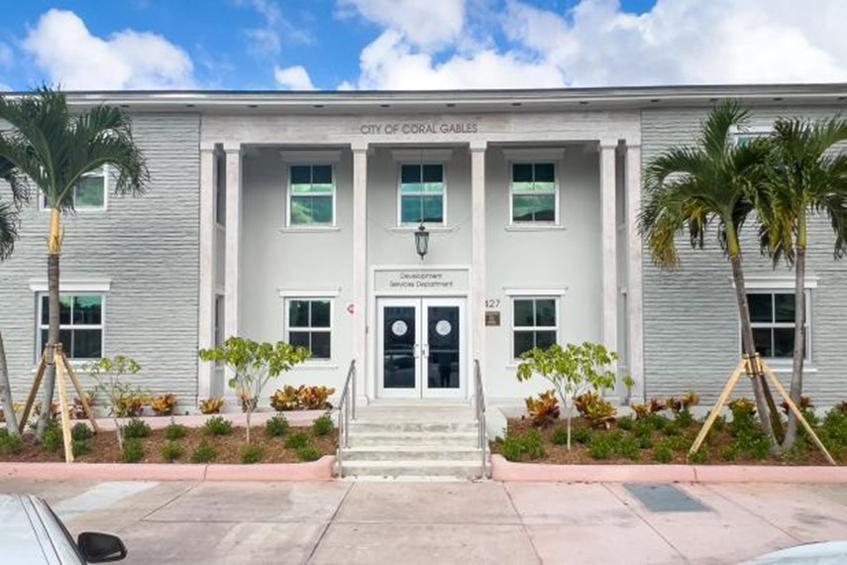
Meet the JRD Team
Building Permitting
One-stop shop permitting center
Permit counter average wait time of 2.5 minutes
Fully electronic plan review – reducing review times by approximately 80%
All Development Services forms available online
Customer service initiatives
16

Slide 17
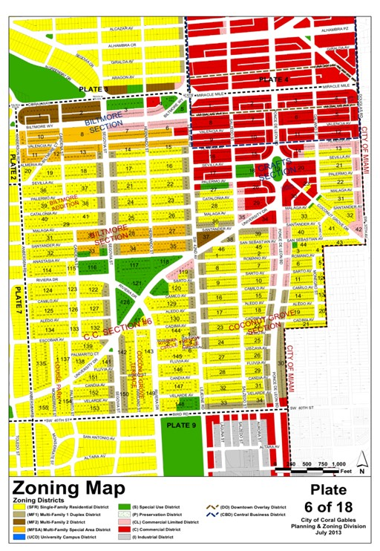
Meet the JRD Team
Zoning and Code Enforcement
Site-specific zoning
Lawful uses that exist under County Code will be permitted to continue (i.e. “grandfathered”)
Florida Building Code requirements
Approach consistent with areas that have been annexed into Coral Gables, including Snapper Creek, Pine Bay Estates, Hammock Lakes, Deering Bay, and King’s Bay
17

Slide 18
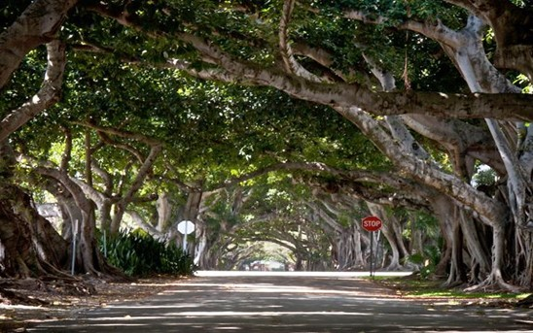

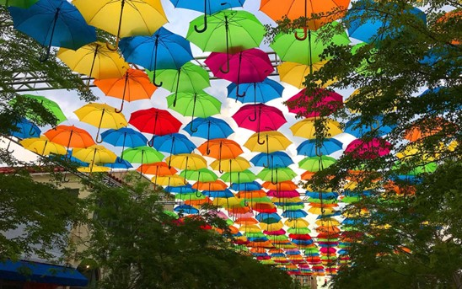
Meet the JRD Team
Recognized City Attributes
Environmentally-Conscious
Smart
Cultural
Tree City, USA
Green Business
Certification Program
Keep Coral Gables Beautiful
Electric vehicles
Online access to city services
Smart poles with free Wi-Fi, CCTV, traffic, safety, and environmental sensors
More than 25 public Wi-Fi sites
Coral Gables Art in Public Places (AiPP) since 2010
More than 20 permanent art installations throughout the city
18

Slide 19
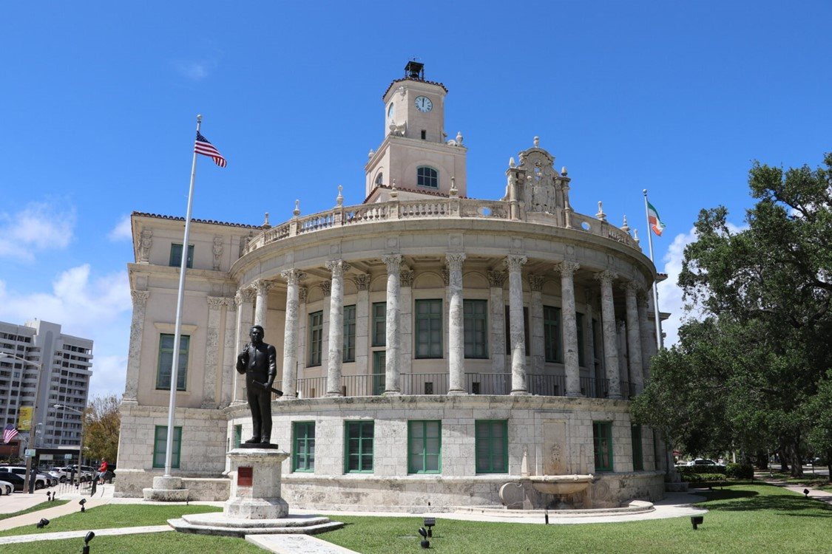
Meet the JRD Team
Open and Accessible City Government
City “Ombudsman” available to assist residents and businesses
Weekly electronic newsletter
New state-of-the-art website
Commission and board meetings are available on Zoom, with public comment Zoom capability
More than 35 resident advisory boards and committees
City App
19

Slide 20
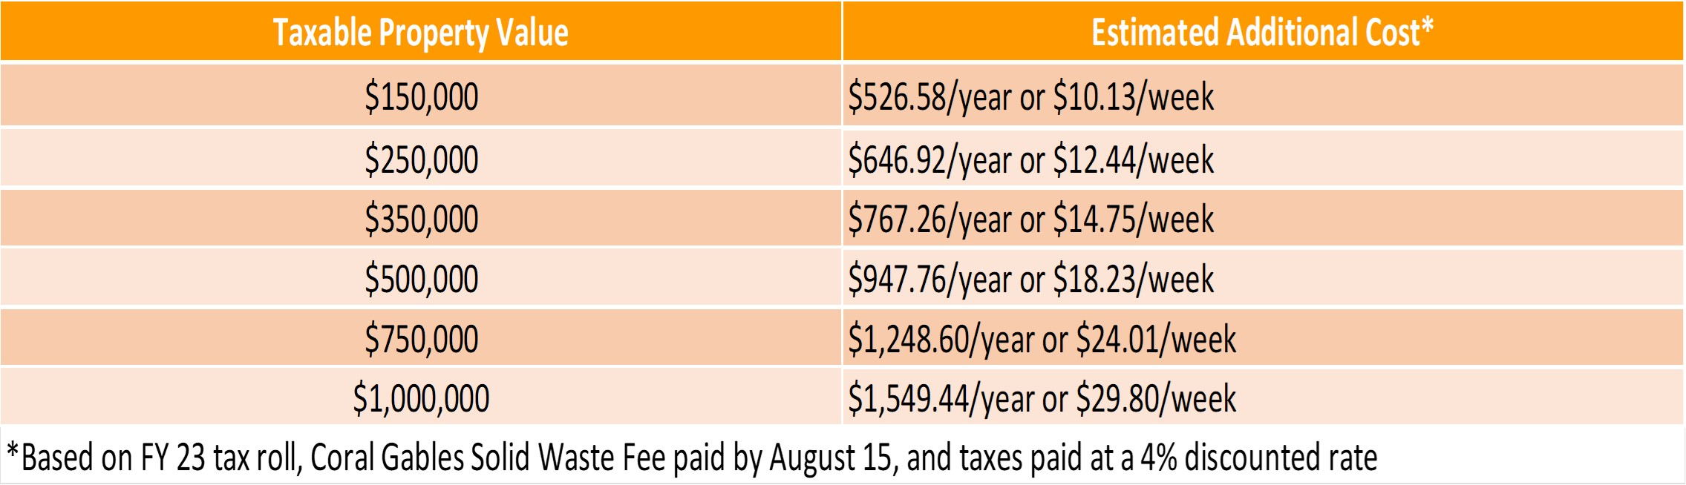
Financial Impact of Annexation to Little Gables Residents
Meet the JRD Team
Property values vary widely in Little Gables, so the estimated additional cost is presented below for a range of taxable property values, and includes property taxes, solid waste fee, and fire fee.
20

Slide 21
Annexation Process Going Forward
Meet the JRD Team
Tabulate petition results; minimum 20% support required for process to move forward*
Staff report to City Commission on petition results*
Noticed City Commission meeting to discuss annexation*
City submits annexation application to Miami-Dade County
County Commission refers City’s annexation request to the County Planning Advisory Board (PAB)*
PAB public hearing on annexation*
County Commission hearings on annexation, including County Policy Committee*
If approved by County Commission, annexation referendum on ballot for Little Gables registered voters to vote on annexation*
* Opportunities for Little Gables residents to be heard
21

Slide 22
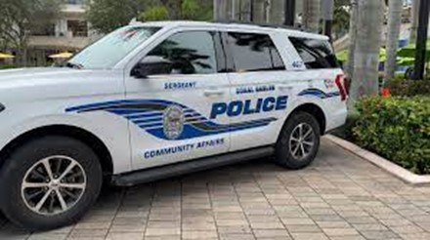
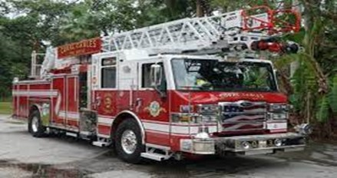

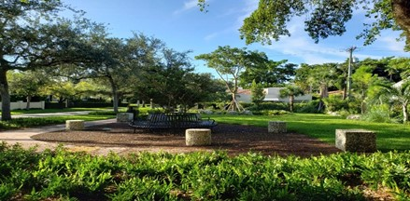
Benefits of Annexation
Meet the JRD Team
Nationally recognized municipal services
Rapid police and fire response
Frequent and convenient waste services
New and enhanced parks
Improved roads, drainage, lighting, landscape, trees, and sidewalks
City Ombudsman to assist residents and businesses
Open and accessible City government
22

Slide 23

Coral Gables
A World Class City with a Hometown Feel
www.coralgables.com/annexation
annexation@coralgables.com
23

Slide 24
Open Discussion / Q & A
24

Slide 25
Coral Gables
A World Class City with a Hometown Feel
www.coralgables.com/annexation
annexation@coralgables.com
25

